Slide 1

Regression Analysis using R
Dr. Talari Ganesh
Department of Mathematics & Scientific Computing
NIT Hamirpur (HP)
Email: drganesh@nith.ac.in

Slide 2
Introduction
Linear regression is used to predict the value of an outcome variable Y based on one or more input predictor variables X. The aim is to establish a linear relationship (a mathematical formula) between the predictor variable(s) and the response variable, so that, we can use this formula to estimate the value of the response Y, when only the predictors (Xs) values are known.
The aim of linear regression is to model a continuous variable Y as a mathematical function of one or more X variable(s), so that we can use this regression model to predict the Y when only the X is known. This mathematical equation can be generalized as follows:
Y = β₁ + β₂ X + ϵ

Slide 3
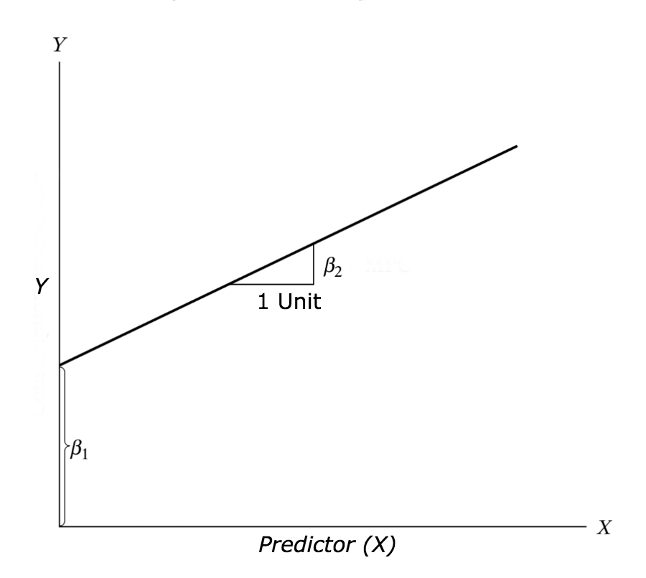
where, β₁ is the intercept and β₂ is the slope. Collectively, they are called regression coefficients. ϵ is the error term, the part of Y the regression model is unable to explain.

Slide 4
Example Problem
You can access this dataset simply by typing in cars in your R console. You will find that it consists of 50 observations(rows) and 2 variables (columns) – dist and speed. Lets print out the first six observations here.

Slide 5
Graphical Analysis
The aim of this exercise is to build a simple regression model that we can use to predict Distance (dist) by establishing a statistically significant linear relationship with Speed (speed). But before jumping in to the syntax, lets try to understand these variables graphically.
Scatter plot: Visualize the linear relationship between the predictor and response
Box plot: To spot any outlier observations in the variable. Having outliers in your predictor can drastically affect the predictions as they can easily affect the direction/slope of the line of best fit.
Density plot: To see the distribution of the predictor variable. Ideally, a close to normal distribution (a bell shaped curve), without being skewed to the left or right is preferred.

Slide 6
Scatter Plot
Scatter plots can help visualize any linear relationships between the dependent (response) variable and independent (predictor) variables. Ideally, if you are having multiple predictor variables, a scatter plot is drawn for each one of them against the response, along with the line of best.
scatter.smooth(x=cars$speed,y=cars$dist, main="Dist ~ Speed")

Slide 7
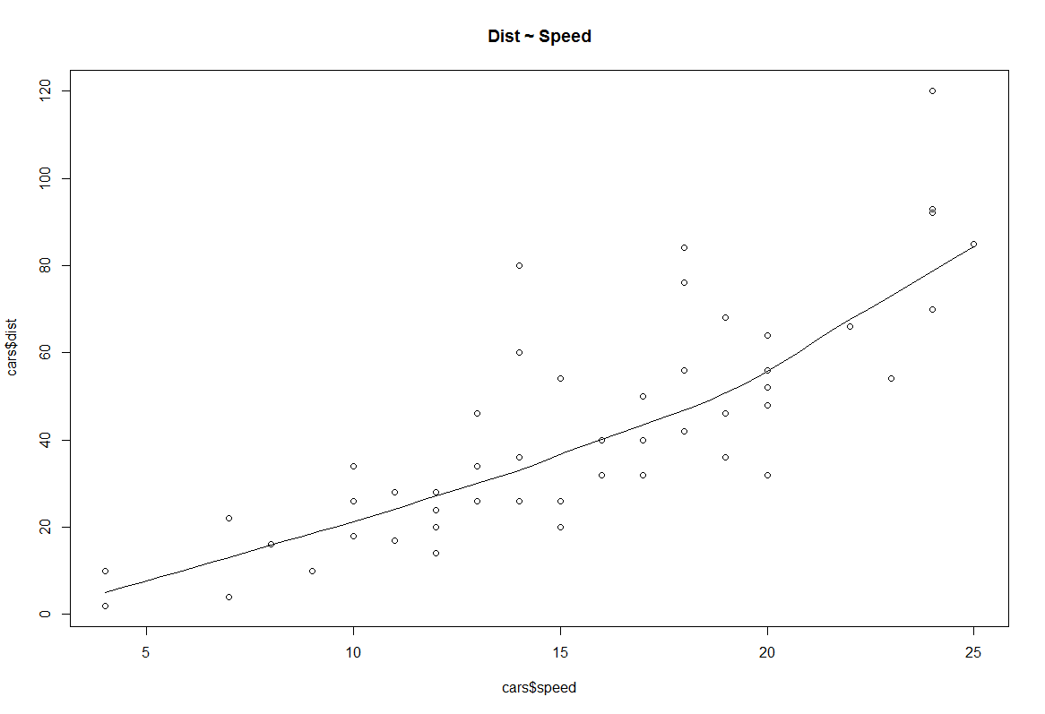

Slide 8
BoxPlot – Check for outliers
Generally, any datapoint that lies outside the 1.5 * interquartile-range (1.5 * IQR) is considered an outlier, where, IQR is calculated as the distance between the 25th percentile and 75th percentile values for that variable.
par(mfrow=c(1, 2)) # divide graph area in 2 columns
boxplot(cars$speed,main="Speed", sub=paste("Outlier rows: ", boxplot.stats(cars$speed)$out)) # box plot for 'speed'
boxplot(cars$dist, main="Distance", sub=paste("Outlier rows: ", boxplot.stats(cars$dist)$out)) # box plot for 'distance'

Slide 9
Density plot – Check if the response variable is close to normality
library(e1071)
par(mfrow=c(1, 2)) # divide graph area in 2 columns
plot(density(cars$speed), main="Density Plot: Speed", ylab="Frequency", sub=paste("Skewness:", round(e1071::skewness(cars$speed), 2))) # density plot for 'speed'
polygon(density(cars$speed), col="red")
plot(density(cars$dist), main="Density Plot: Distance", ylab="Frequency", sub=paste("Skewness:", round(e1071::skewness(cars$dist), 2))) # density plot for 'dist'
polygon(density(cars$dist), col="red")

Slide 10
Build Linear Model
The function used for building linear models is lm(). The lm() function takes in two main arguments, namely: 1. Formula 2. Data.
The data is typically a data.frame and the formula is a object of class formula. But the most common convention is to write out the formula directly in place of the argument as written below.
linearMod <- lm(dist ~ speed, data=cars) # build linear regression model on full data
print(linearMod)

Slide 11
Model Diagnostics
Now the linear model is built and we have a formula that we can use to predict the dist value if a corresponding speed is known. Is this enough to actually use this model? NO! Before using a regression model, you have to ensure that it is statistically significant. How do you ensure this? Lets begin by printing the summary statistics for linearMod.
summary(linearMod)

Slide 12
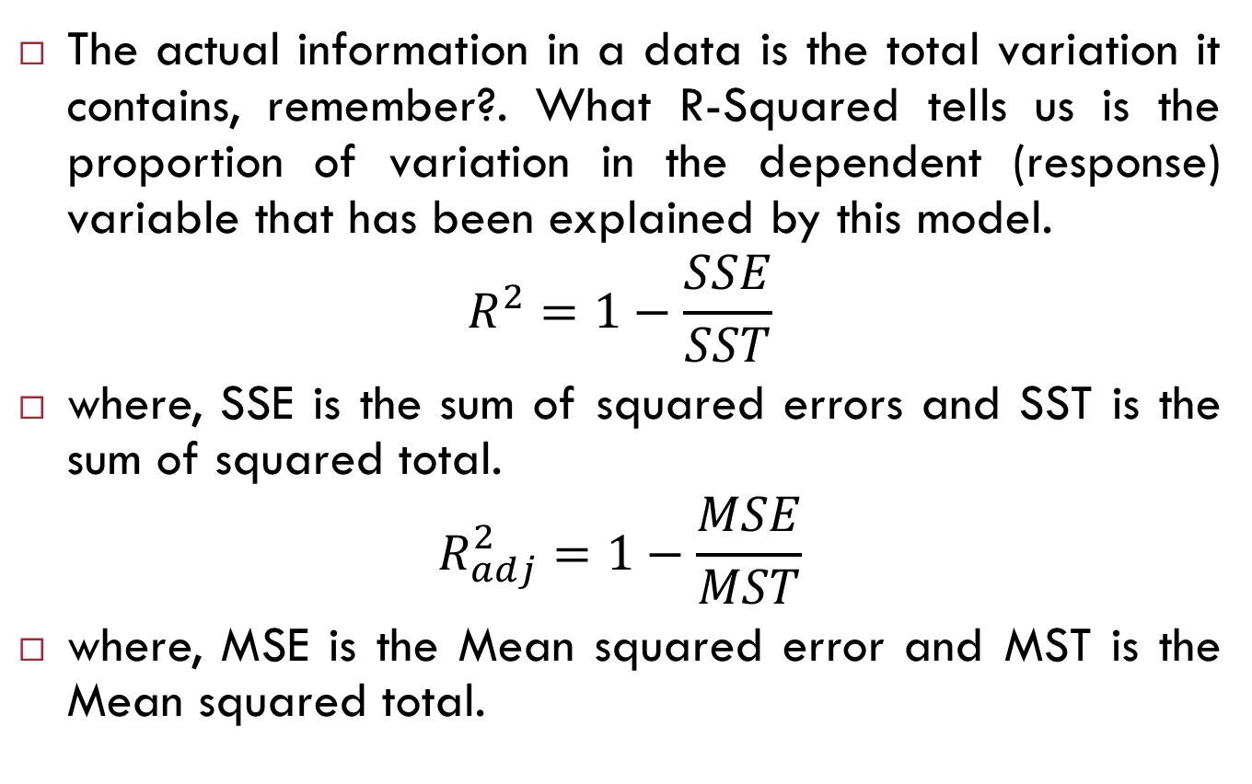
R-Squared and Adj R-Squared
The actual information in a data is the total variation it contains, remember?. What R-Squared tells us is the proportion of variation in the dependent (response) variable that has been explained by this model.
$$R^{2}=1−\frac{SSE}{SST}$$
where, SSE is the sum of squared errors and SST is the sum of squared total.
$$R_{adj}^{2}=1−\frac{MSE}{MST}$$
where, MSE is the Mean squared error and MST is the Mean squared total.

Slide 13
Predicting Linear Models
So far we have seen how to build a linear regression model using the whole dataset. If we build it that way, there is no way to tell how the model will perform with new data. So the preferred practice is to split your dataset into a 80:20 sample (training:test), then, build the model on the 80% sample and then use the model thus built to predict the dependent variable on test data.
Doing it this way, we will have the model predicted values for the 20% data (test) as well as the actuals (from the original dataset). By calculating accuracy measures (like min_max accuracy) and error rates (MAPE or MSE), we can find out the prediction accuracy of the model.

Slide 14
Create the training (development) and test (validation) data samples from original data.
set.seed(100) # setting seed to reproduce results of random sampling
trainingRowIndex <- sample(1:nrow(cars), 0.8*nrow(cars)) # row indices for training data
trainingData <- cars[trainingRowIndex, ] # model training data
testData <- cars[-trainingRowIndex, ] # test data

Slide 15
Develop the model on the training data and use it to predict the distance on test data
lmMod <- lm(dist ~ speed, data=trainingData) # build the model
distPred <- predict(lmMod, testData) # predict distance
Review diagnostic measures.
summary (lmMod)

Slide 16
Calculate prediction accuracy and error rates
actuals_preds=data.frame(cbind(actuals=testData$dist, predicteds=distPred)) # make actuals_predicteds dataframe.
correlation_accuracy=cor(actuals_preds)
head(actuals_preds)
Now lets calculate the Min Max accuracy and MAPE
min_max_accuracy=mean(apply(actuals_preds, 1, min) / apply(actuals_preds, 1, max))
mape=mean(abs((actuals_preds$predicteds - actuals_preds$actuals))/actuals_preds$actuals)

Slide 17


